Slide 1

Introduction to
DEVELOPMENT FRAMEWORK FOR PHARMACISTS
Chief Pharmacist’s Office
June 2021
Notes:
INTRODUCTION
On 22 May 2020, the Development Framework for Pharmacists (DFP) was published by the Ministry of Health

Slide 2

Education & Training Continuum for Pharmacists
SPC Entry-to-Practice Competency Standards for Pharmacists
Development Framework for Pharmacists (DFP)
Undergraduate Degree* | Post-course Pre-registration training | Foundation Practice | Advanced Practice (Intermediate - Advanced - Expert)
* Include 24 weeks of Pre-Employment Clinical Training (PECT) in Year 4
28 weeks of Clinical Training
Post-registration experience | Postgraduate Education
 | Master degree / PharmD
Residency |  | Post-residency experience | Specialist Practice
R1 | R2
Registered Pharmacist
Registered Specialist
Introduction to Development Framework for Pharmacists. Copyright © Ministry of Health, Singapore (2021). Version 1.0: June 2021
Notes:
EDUCATION & TRAINING CONTINUUM FOR PHARMACISTS
This chart shows the education and training continuum for pharmacists.
In Singapore, there are several frameworks developed to define the competencies of pharmacists.
The Singapore Pharmacy Council published the Competency Standards for Pharmacists for licensure at entry level.
In 2016, MOH introduced the Competency Standards for Pharmacists in Advanced Practice (APF).
However, there was no formal adoption of a development framework between entry level and advanced practice. Hence, the DFP was conceived to establish a clear linkage between foundation and advanced practice.

Slide 3

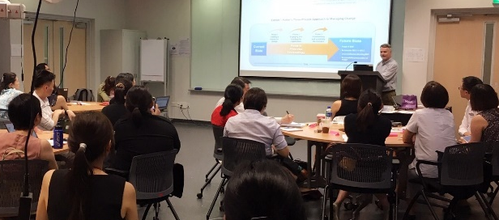

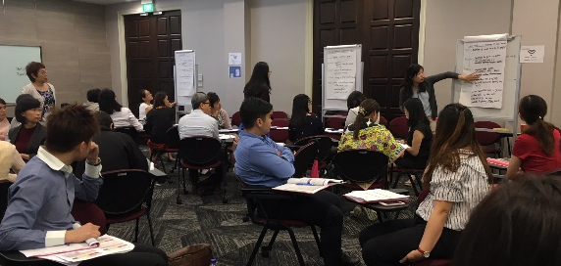
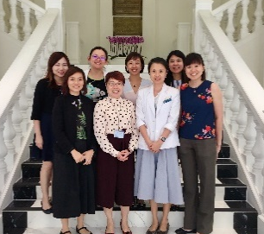
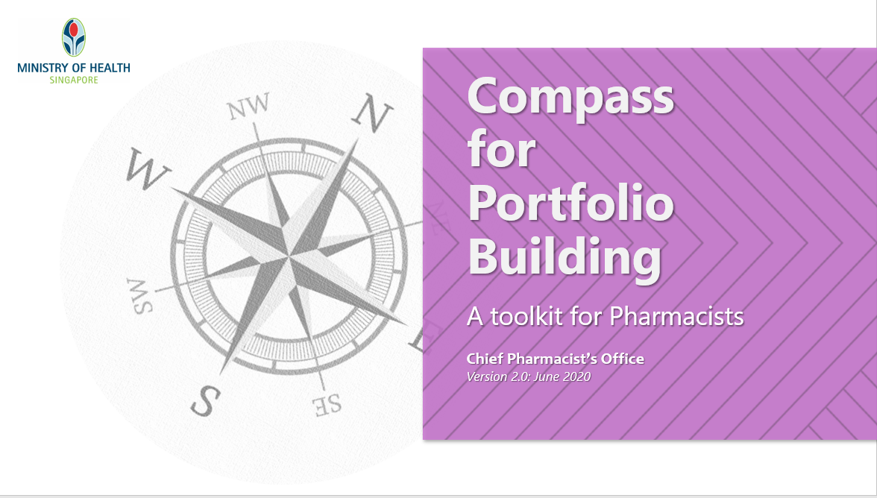
Development Framework for Pharmacists (DFP)
The developmental journey…
Scan to find out more
Advanced Practice Framework (APF) Development (2010-2016)
Portfolio Training Workshops (2018-2020)
Review of APF Implementation (2019)
Development Framework for Pharmacists (2020)
APF Guidebook (2017)
Portfolio Building Toolkit (2019)
Integration of SPC Entry-to-Practice Competency Standards into DFP (Ongoing)
APF Roadshows (2016-2017)
SPC Competency Standards for Pharmacists (Entry-to-Practice) (2011)
Introduction to Development Framework for Pharmacists. Copyright © Ministry of Health, Singapore (2021). Version 1.0: June 2021
Notes:
DEVELOPMENT FRAMEWORK FOR PHARMACISTS – The developmental journey
The Ministry of Health Singapore developed the pharmacist career pathway framework in 2009. To facilitate implementation of the career pathway framework, there was a need to develop a competency framework to map out the level of competency that would be required of pharmacists at different levels of seniority and expertise.
The competency domains in the UK CoDEG ALF was found to be aligned with pharmacists’ scope of practice in Singapore and was successfully introduced to pharmacists in SGH. Hence, the decision for the competency framework for pharmacists in advanced practice (APF) to be adapted from the CODEG ALF.
In 2010, Chief Pharmacist’s Office (CPO) of the Ministry of Health collaborated with public healthcare institutions to develop competency standards for pharmacists in advanced practice (APF). The competency standards from CODEG ALF was adapted for this purpose. A validation study was conducted in 2014 and the results indicated that the competency framework demonstrated good reliability and validity for measuring competency of advanced pharmacy practitioners. The APF was introduced in 2016 to healthcare institutions.
The APF was implemented as a developmental tool for pharmacists to advance systematically across 6 competency domains. From 2016 to 2017, APF roadshows were conducted at healthcare insitutions to introduce the framework to pharmacists across sectors. After significant development and professional engagement, the APF guidebook was published in 2017 for pharmacists to actively use the framework in practice.
In 2018, a review of training roadmaps across sectors to understand training gaps and emerging training needs for advanced practitioners was conducted. Portfolio training workshops were commissioned by the Ministry of Health to Tan Tock Seng Hospital. Since then, 19 portfolio training workshops involving over 400 senior pharmacists were conducted and a portfolio building toolkit was developed to strengthen the communication of the vision and to promote adoption of the framework.
There were regular engagements with pharmacy leaders and pharmacists for sharing of experience on progress of APF implementation. In 2019, the APF implementation was reviewed with visiting expert Professor Michael Dooley (Alfred Health/Monash University, Australia). While various frameworks were in place to define competencies for pharmacists in Singapore, there was no formal adoption of a framework between entry level and advanced practice. To illustrate the competency continuum of pharmacists, the Development Framework for Pharmacists (DFP) was formed with the addition of foundation level competencies to the APF. The DFP was published in May 2020.
To facilitate the transition from school to the pharmacy workplace, the Entry-to-Practice competency standards for pharmacists by the SPC would be integrated into the DPF. SPC has set up a workgroup to review the entry-to-practice competency standards for integration into the DFP in 2021.

Slide 4
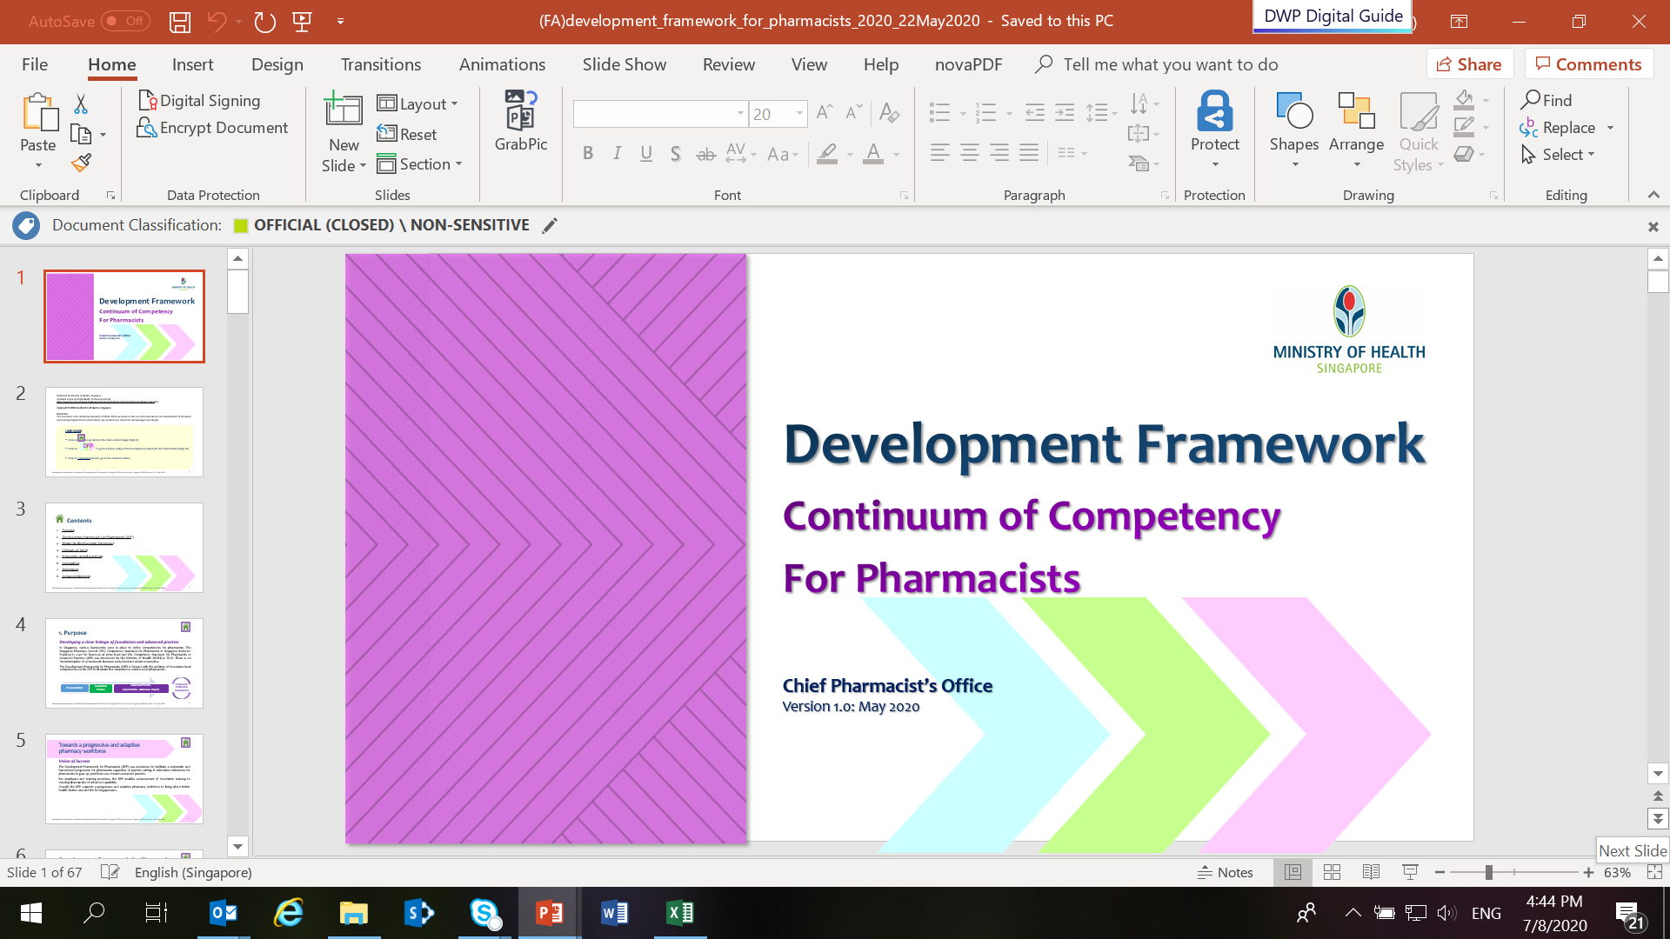

Development Framework for Pharmacists
Empowering pharmacists to take charge of their professional development
Provide clarity on scope of practice and the competencies required for pharmacists to gear up, post licensure, towards advanced practice
Facilitate effective use of resources for training and development of pharmacists
Promote a culture of lifelong learning
Download the document HERE or scan the QR code
Pre-Foundation
Foundation Practice
Advanced Practice
(Intermediate - Advanced - Expert)
Continuing Professional Development
Introduction to Development Framework for Pharmacists. Copyright © Ministry of Health, Singapore (2021). Version 1.0: June 2021
Notes:
DEVELOPMENT FRAMEWORK FOR PHARMACISTS – The purpose of DFP
The competency continuum within DFP equips pharmacists to practice from foundation to advanced levels.
The DFP supports the profession’s commitment to lifelong learning.
It serves as a guide for pharmacists to be deliberate in planning for their own professional development and to seek out opportunities in the current and emerging practice areas.
The implementation of DFP facilitates advancement of foundation training by employers and training providers to develop pharmacists of enhanced capabilities.

Slide 5

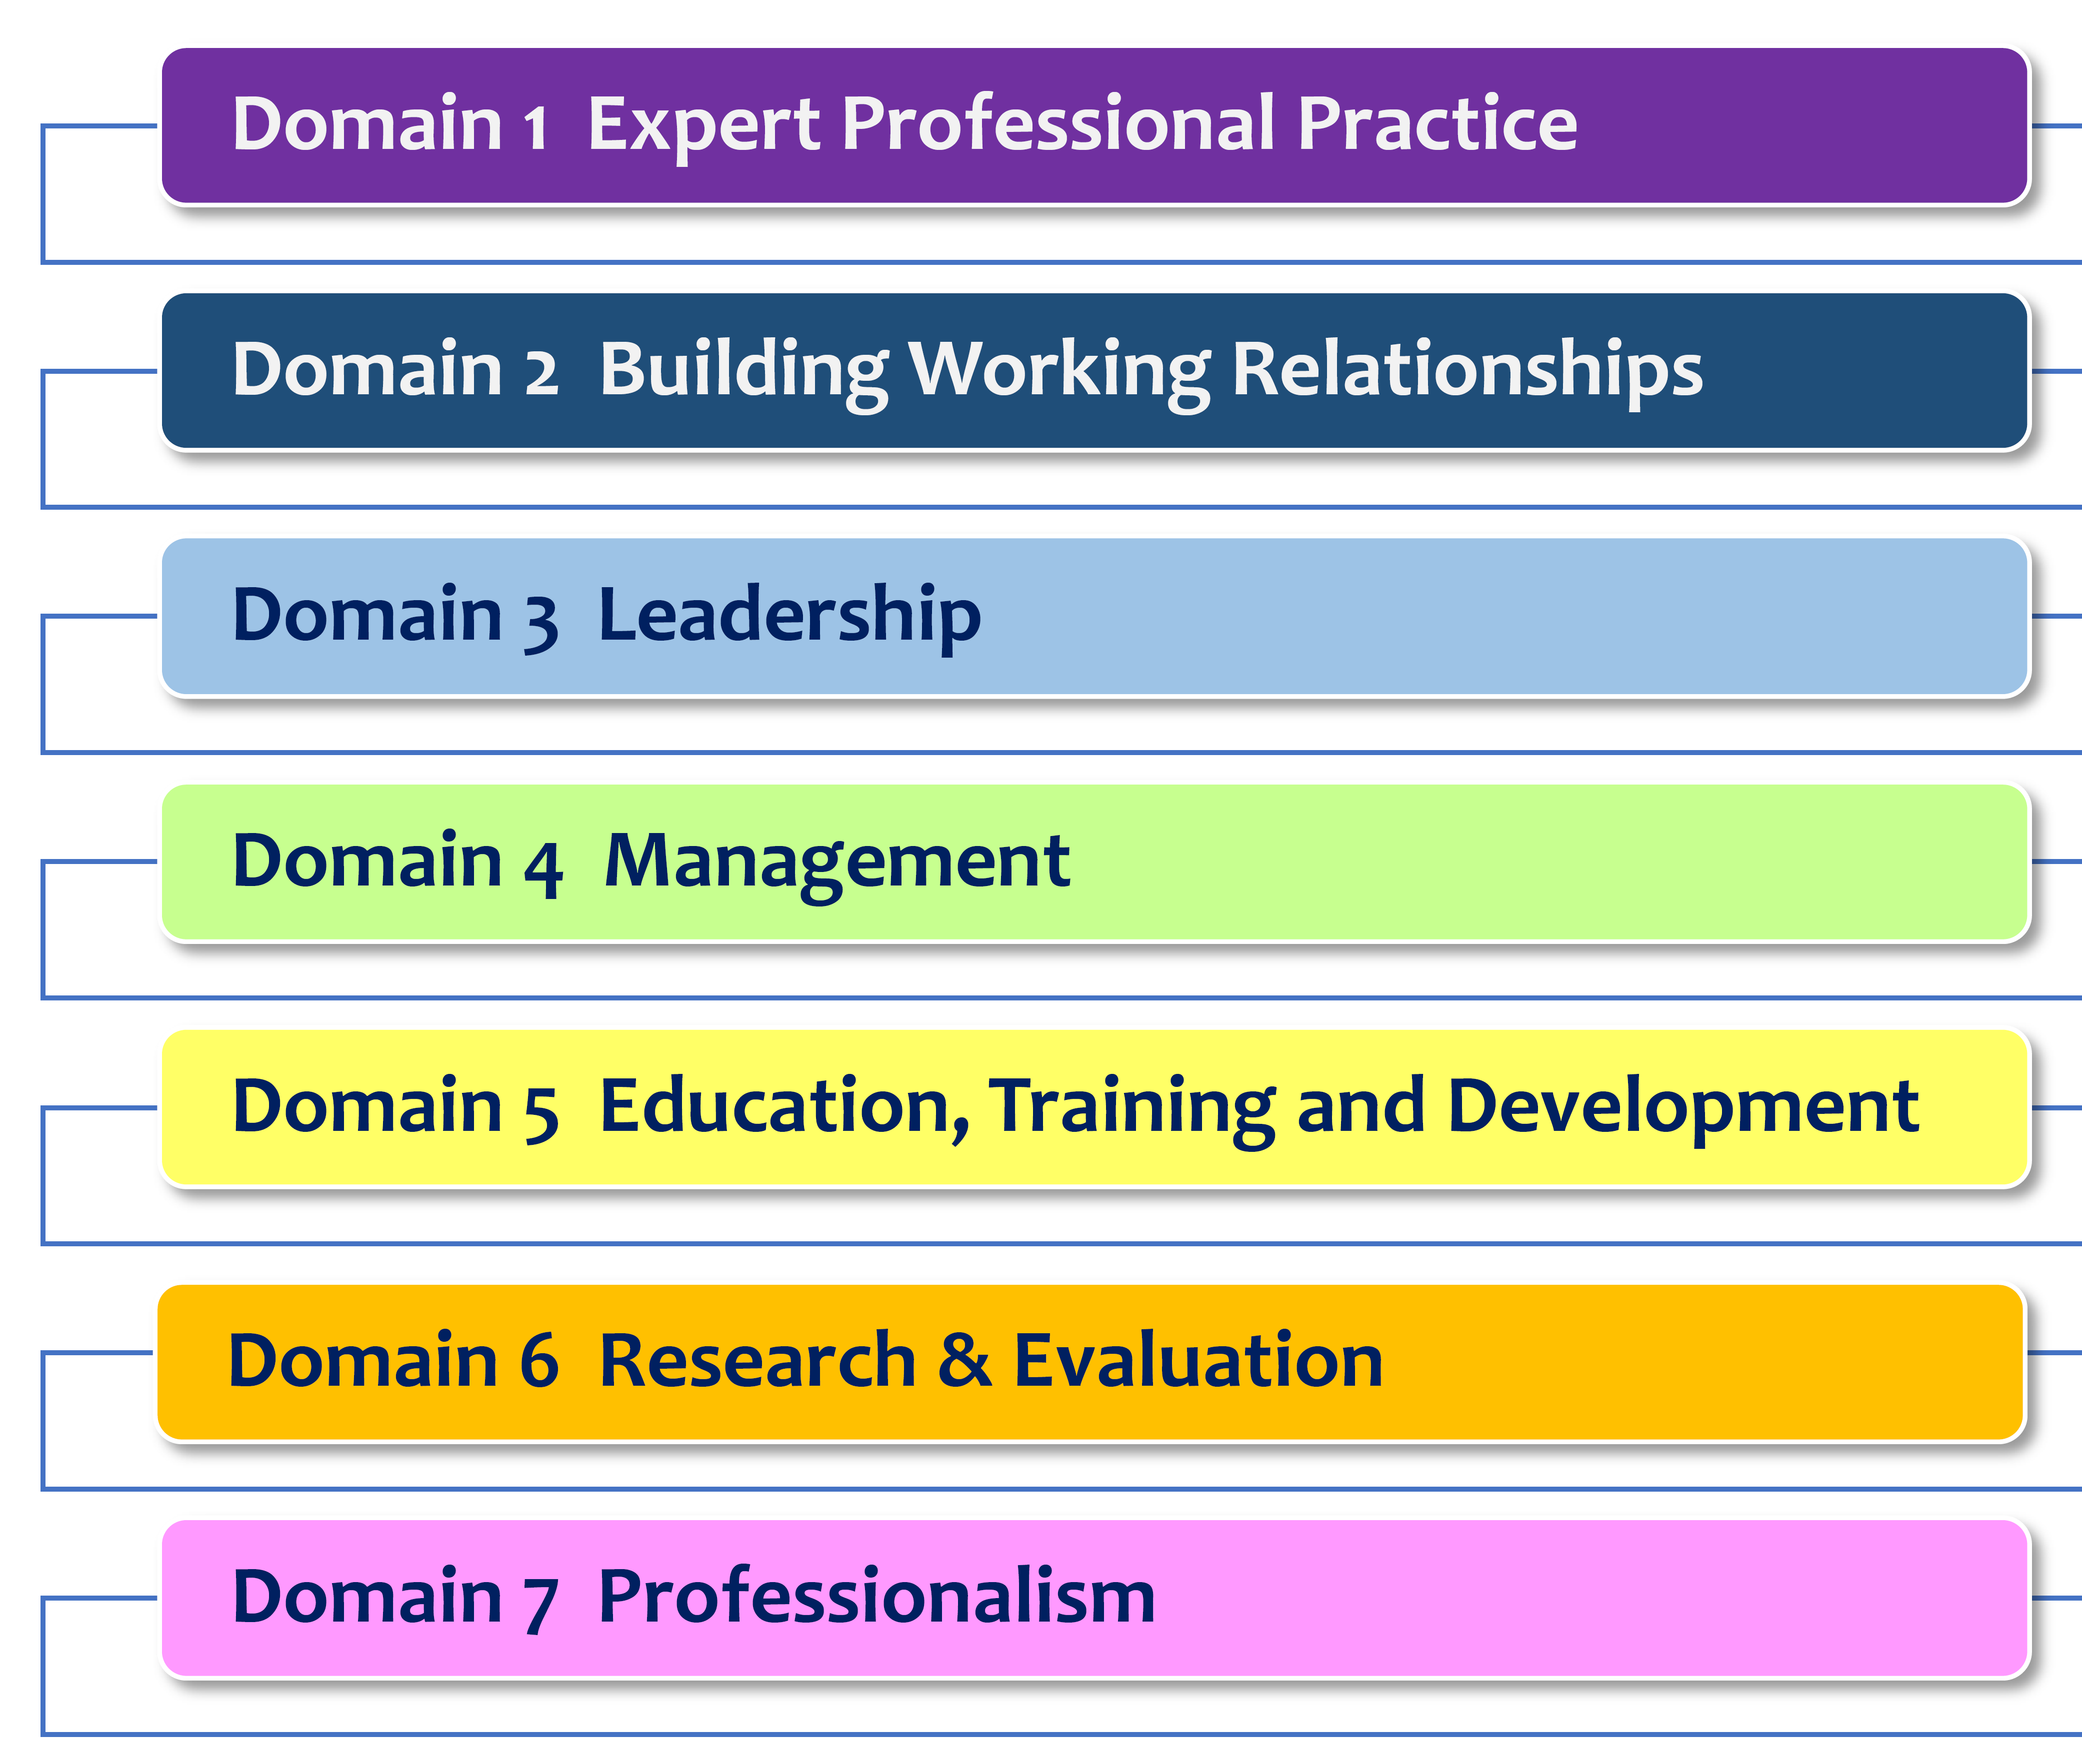
The DFP establishes a competency continuum across 7 domains
The DFP comprises 28 competency standards across 7 domains. Domains 1 to 6 are competency standards in the Advanced Practice Framework (APF) extended to include foundation level standards.
Domain 7 on professionalism was added for seamless transition from Entry-to-Practice Competency Standards by SPC. Competencies on professionalism are to be attained in foundation years.
Introduction to Development Framework for Pharmacists. Copyright © Ministry of Health, Singapore (2021). Version 1.0: June 2021
Notes:
DEVELOPMENT FRAMEWORK FOR PHARMACISTS – The competency continuum across 7 domains
The DFP comprises 28 competency standards across 7 domains: these include expert professional practice, building working relationships, leadership, management, education, training and development, research and evaluation, as well as professionalism.
The first six domains are competency standards in the APF extended to include foundation level standards.
Domain 7 on professionalism was added for seamless transition from Entry-to-Practice Competency Standards by the Singapore Pharmacy Council.

Slide 6


4 performance levels associated with
learning and career progression
Each of the competency standards for the first 6 domains is presented at four performance levels of Foundation, Intermediate, Advanced and Expert. The four performance levels reflect the performance continuum associated with learning and career progression and are defined as¹:
Foundation
Able to successfully complete tasks with help from an expert
Focus on acquisition of knowledge or skill
Intermediate
Able to successfully complete tasks with occasional help from an expert
Focus on applying and enhancing knowledge or skill
Advanced
Routinely manages complex situations and a recognised “person to ask” in the organisation
Focus on broad organizational or professional issues
Expert
Recognised as an authority in that area of expertise, alongside a breadth of experience
Able to explain issues in relation to broader organizational issues, creates new applications and processes
Focus on strategic planning
1. Adapted from Competencies Proficiency Scale. Office of Human Resources at the National Institute of Health. Accessed at https://hr.nih.gov/working-nih/competencies/competencies-proficiency-scale on 11 May 2020
Introduction to Development Framework for Pharmacists. Copyright © Ministry of Health, Singapore (2021). Version 1.0: June 2021
Notes:
DEVELOPMENT FRAMEWORK FOR PHARMACISTS – The 4 performance levels
The competency continuum under the DFP has a tiered and progressive structure to enable systematic progression and continuous professional development.
Foundation – Able to successfully complete tasks with help from an expert. Focus is on acquisition of knowledge or skill
Intermediate – Able to successfully complete tasks with occasional help from an expert. Focus is on applying and enhancing knowledge or skill.
Advanced – Routinely manages complex situations and a recognised “person to ask” in the organisation. Focus is on broad organizational/professional issues.
Expert - Recognised as an authority in that area of expertise, alongside a breadth of experience. Able to explain issues in relation to broader organizational Issues. Creates new applications and processes.

Slide 7
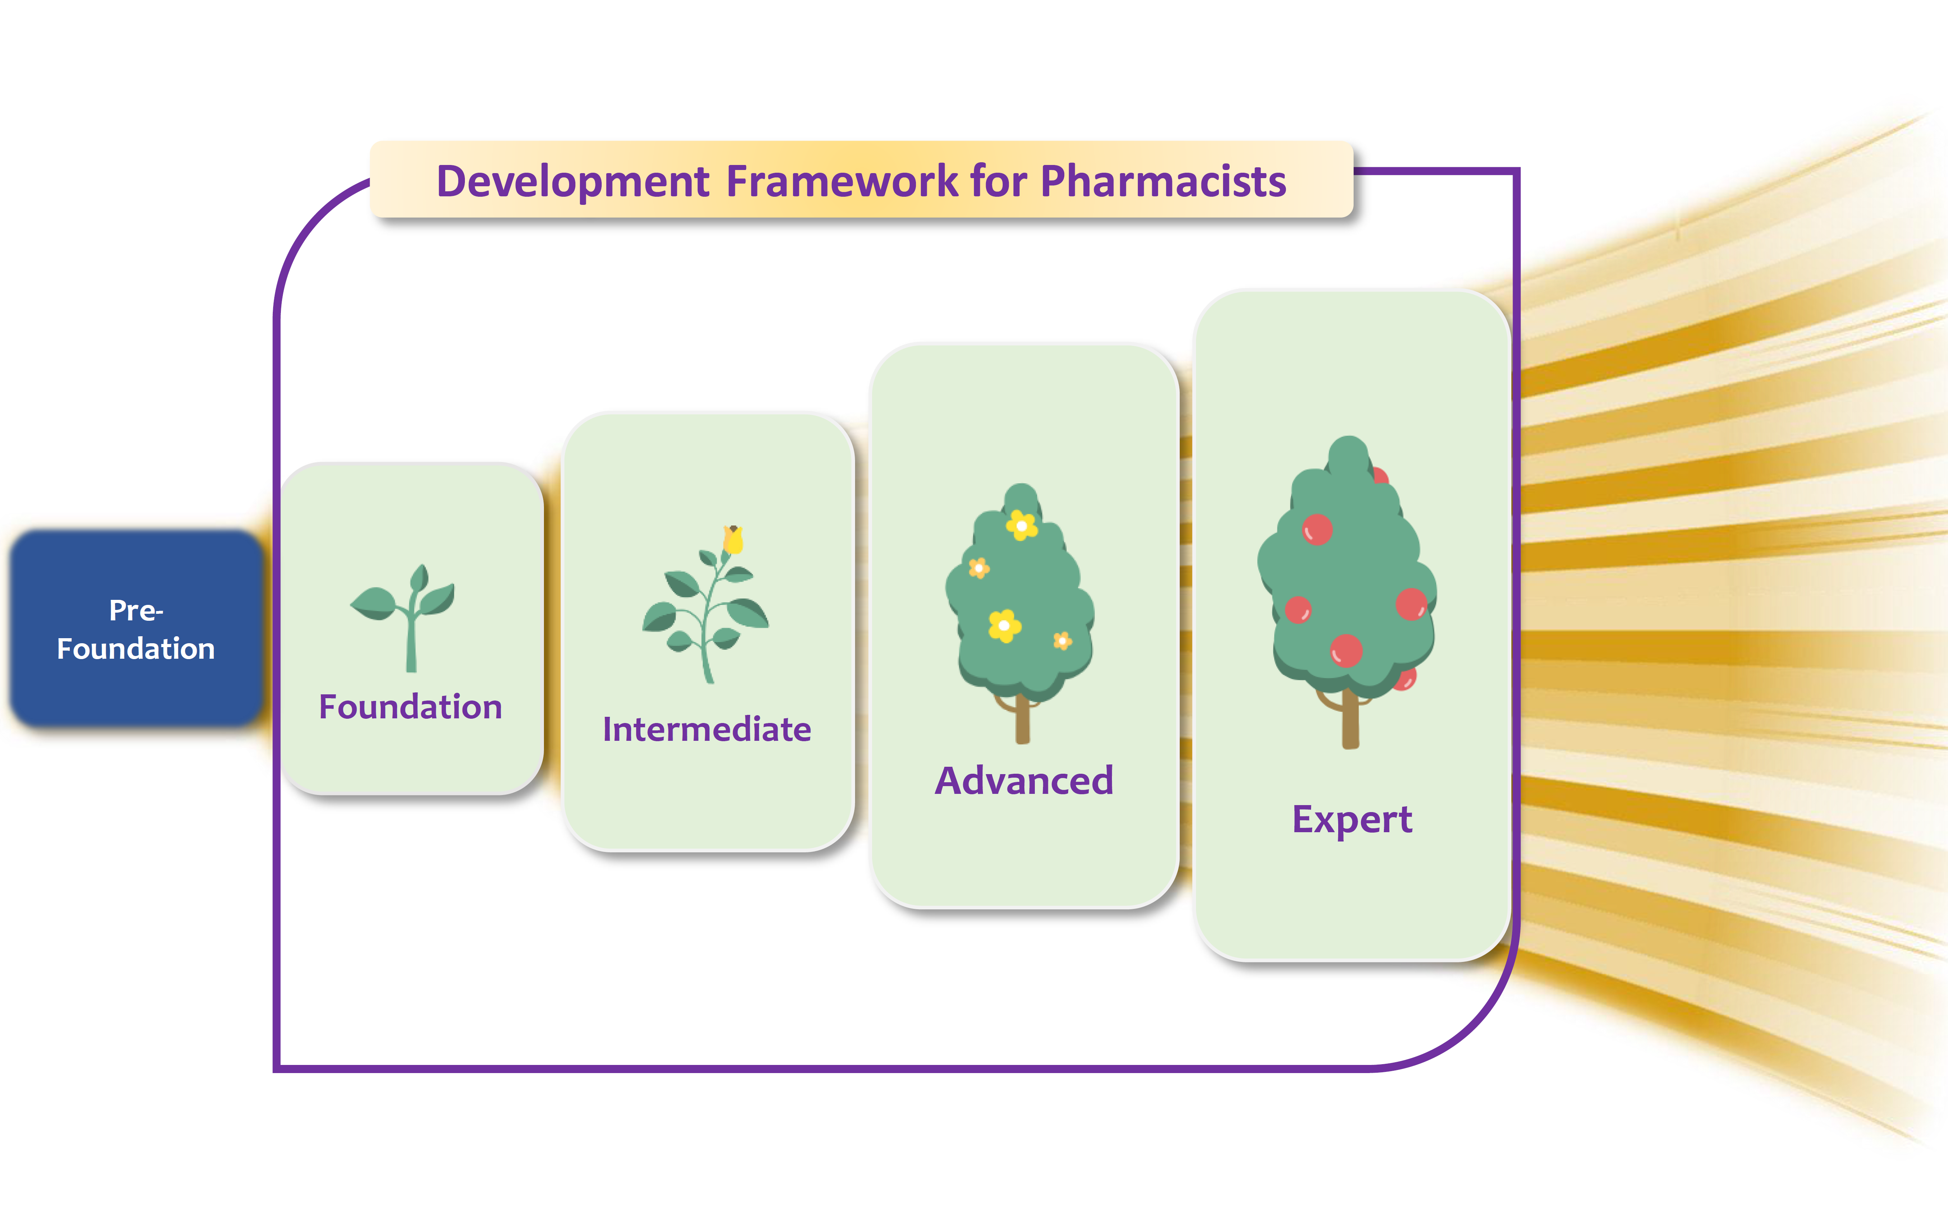
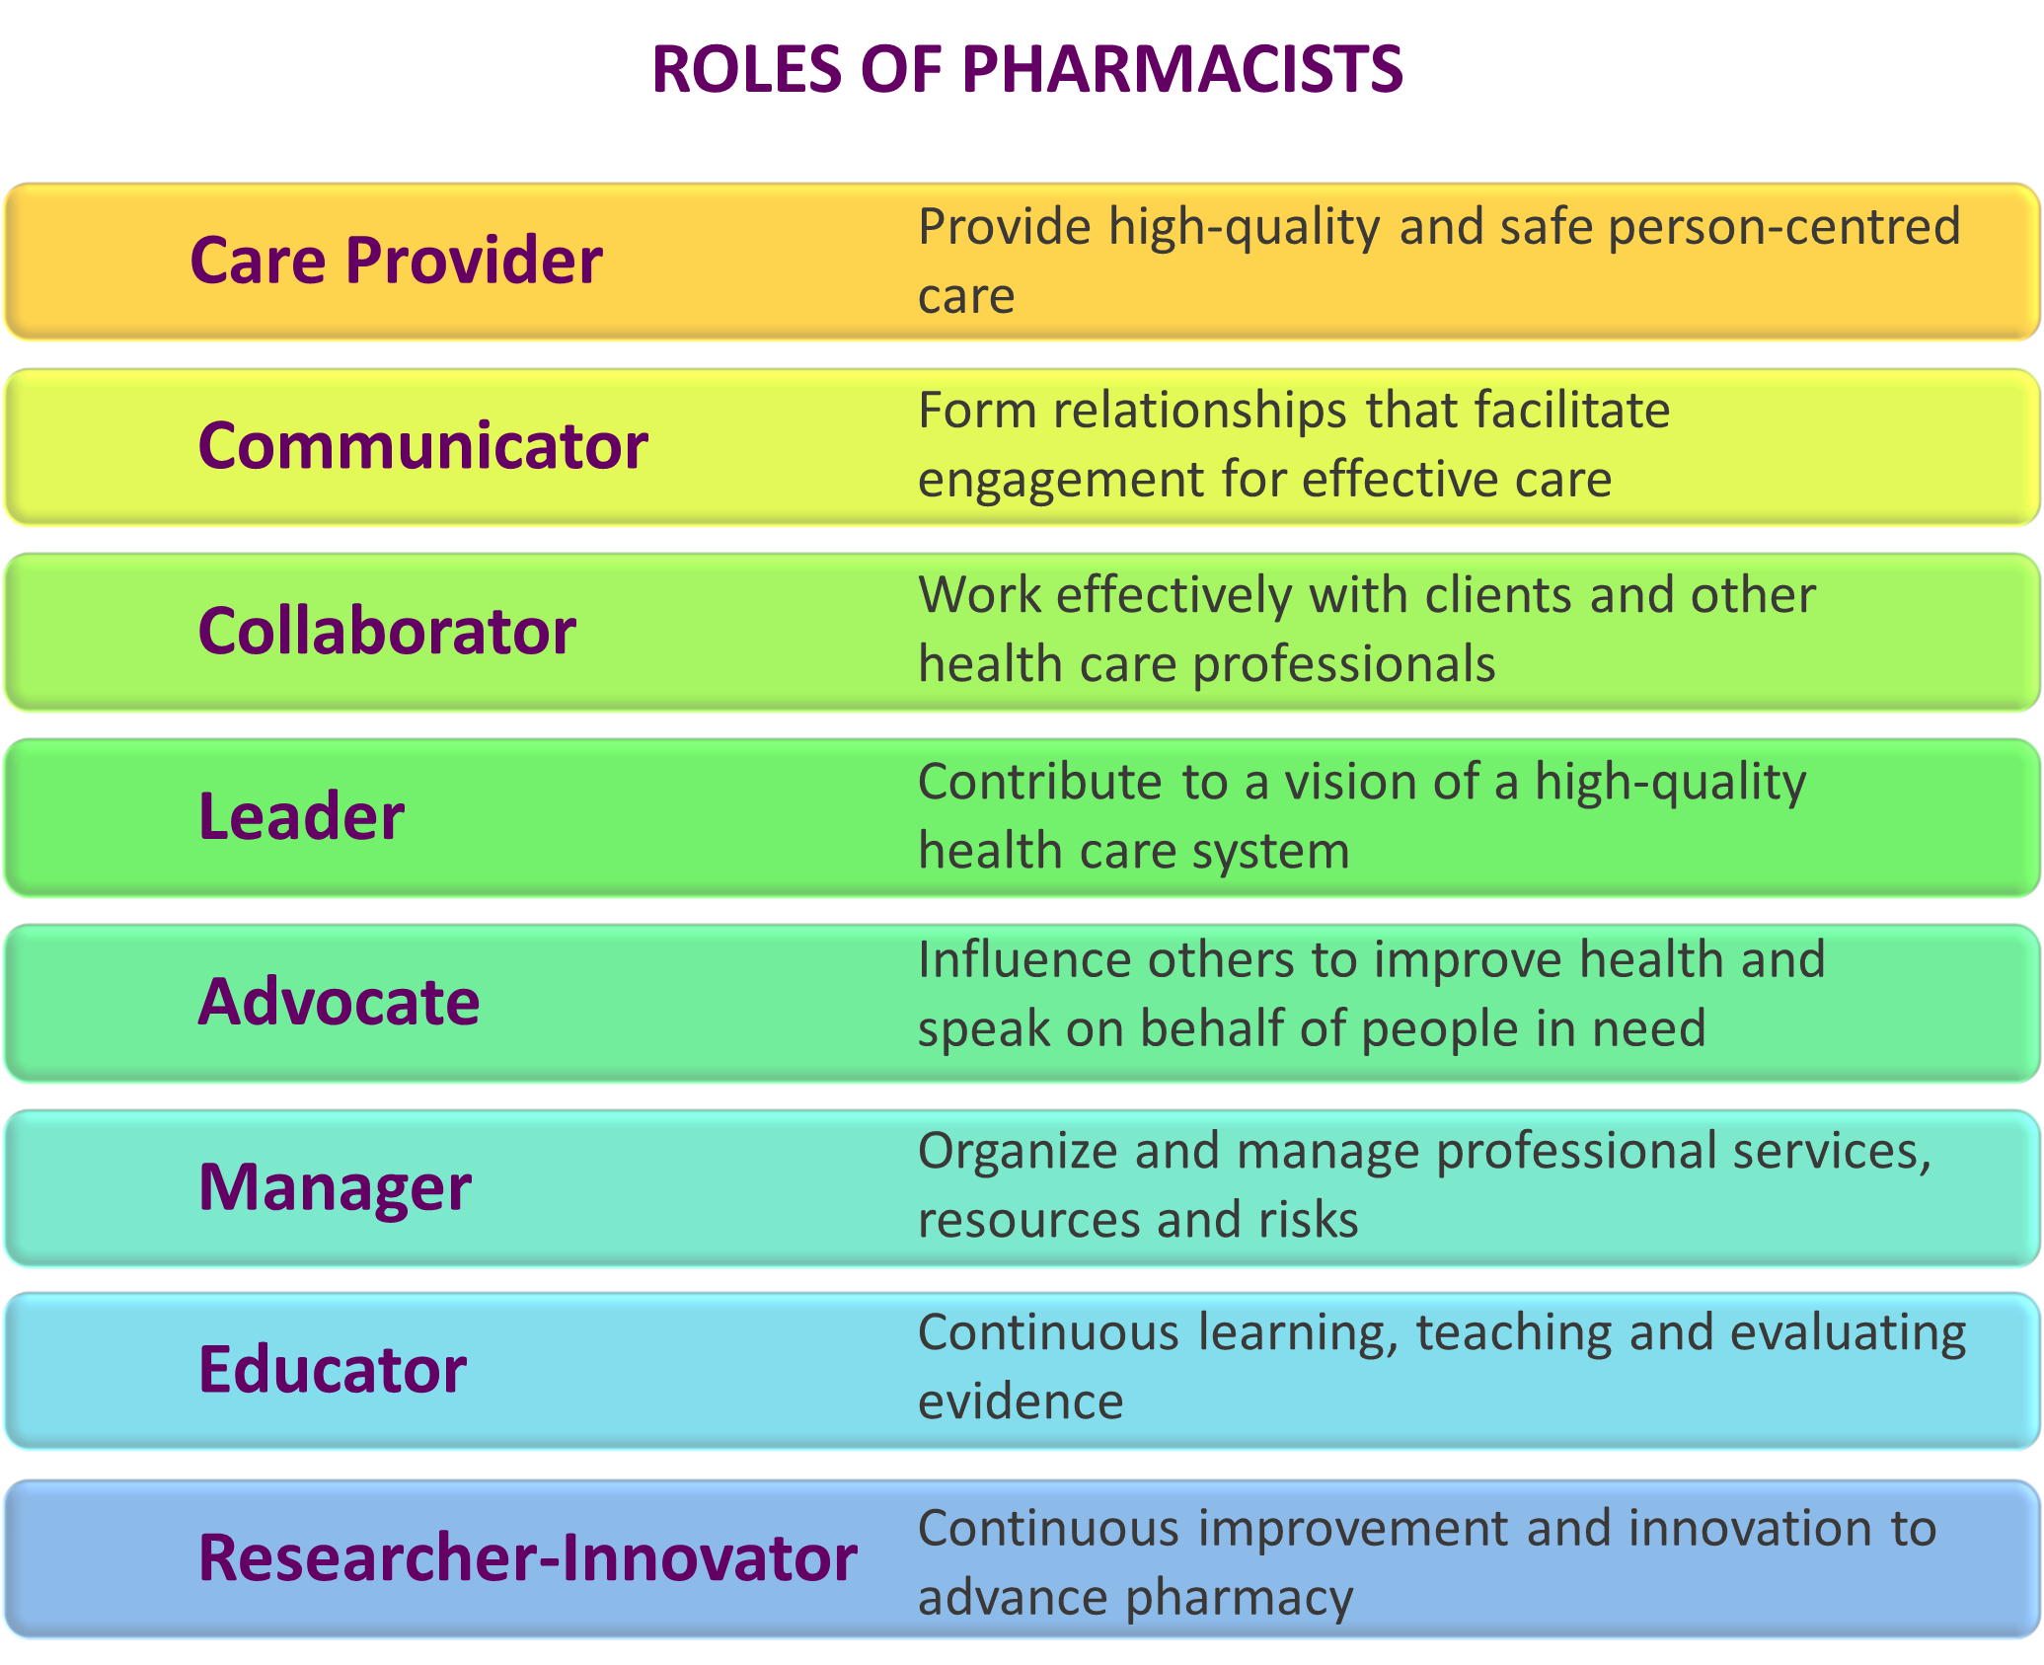

Continuum of Competency towards 8 key roles
Introduction to Development Framework for Pharmacists. Copyright © Ministry of Health, Singapore (2021). Version 1.0: June 2021
Notes:
DEVELOPMENT FRAMEWORK FOR PHARMACISTS – Towards 8 Key Roles
The DFP aimed at facilitating a systematic and harmonized progression to develop pharmacists of enhanced capability in eight key roles – care provider, collaborator, communicator, health advocate, leader, manager, educator and researcher-innovator.
Through the DFP, the required competencies underpinning the development of the eight key roles were identified.
The multiple roles will enable pharmacists to diversify by acquiring multiple skillsets.
This approach allows pharmacists to build resilience and adaptability
Further elaboration on the roles of pharmacists:
Care Provider: Provide high-quality and safe person-centred care
Communicator: Form relationships that facilitate engagement for effective care
Collaborator: Work effectively with clients and other health care professionals
Leader: Contribute to a vision of a high-quality health care system
Advocate: Influence others to improve health and speak on behalf of people in need
Manager: Organize and manage professional services, resources and risks
Educator: Continuous learning, teaching and evaluating evidence
Researcher-Innovator: Continuous improvement and innovation to advance pharmacy

Slide 8
Implementation timeline
2019 > CREATE | 2020 > LAUNCH | 2021 > TRANSIT | 2022 > REVIEW
Consulting and developing the framework Review of APF implementation by HMDP VE Prof Michael Dooley Development of foundation level competency standards Consultation with SPC council members and education leads across clusters | Introducing the DFP Consultation with education leads across sectors Launch Development Framework for Pharmacists (DFP) in May 2020 Conduct APF surveys | Clarifying the vision of success Engagement with pharmacy workforce and relevant stakeholders Portfolio training workshops and consultations for institutions Launch Portfolio Toolkit V2.0 | Formalising the DFP and charting the next phase Continued engagements with pharmacy workforce and relevant stakeholders Review of DFP implementation and CPD readiness (with SPC/NUS) End of transitional implementation phase of DFP
Introduction to Development Framework for Pharmacists. Copyright © Ministry of Health, Singapore (2021). Version 1.0: June 2021
Notes:
DEVELOPMENT FRAMEWORK FOR PHARMACISTS – Implementation Timeline
In 2021, we are in the transitional implementation phase, a time for employers and pharmacists to try out the DFP on selective domains or groups of pharmacists
During this period of time (until end of 2022), the DFP serves as a guide for career conversations and a tool to identify developmental needs.
As pharmacists constantly seek to improve and evolve in pursuit of excellence, the need for new competencies will grow. The DFP will be reviewed on a regular basis to ensure currency of purpose.

Slide 9
THANK YOU!
We hope that you find this information useful for communication on the Development Framework for Pharmacists.
For queries and feedback, connect with us at go.gov.sg/cpo-moh

